Slide 1





Combating Fraud in Digital Financial Systems
Insights from the PaySim Dataset
AYUSH PRAJAPATI | 20230015 | MNNIT ALLD.

Slide 2
PROBLEM STATEMENT
DATASET OVERVIEW
Approach & Tools
Digital financial transactions are increasingly vulnerable to fraud.
Fraudulent behavior can disrupt trust, impact users, and cause monetary losses.
Traditional detection systems often fail to catch evolving fraud patterns.
Goal: To identify high-risk transaction types, detect suspicious trends and behaviors, and provide data-driven recommendations through visual storytelling using SQL and Power BI — laying the foundation for future fraud detection systems.
Source: PaySim — a synthetic dataset simulating mobile money transactions in a financial ecosystem
Size: ~1 million transactions (1,048,575 rows)
Key Columns:
type, amount, oldbalanceOrg, newbalanceDest,
isFraud, isFlaggedFraud, etc.
Purpose: Mimics real-world digital financial activity for research in fraud detection
Tools Used: MySQL for analysis, Power BI for visualization
Workflow:
Data Cleaning
SQL Analysis & Feature Engineering
Power BI Dashboards
Insights & Business Recommendations

Slide 3
ANALYSIS AND INSIGHTS

Slide 4
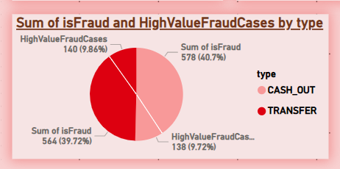
Fraud is Highly Concentrated in Two Transaction Types
Insight:
Over 99% of fraudulent transactions are found in just two types:
➤ CASH_OUT and TRANSFER
TRANSFER has the highest share of high-value frauds.
Other transaction types (PAYMENT, DEBIT, CASH_IN) show almost zero fraud.
This gives us a clear starting point.
Instead of spreading our efforts thin, we know that if we just focus our fraud detection efforts on these two transaction types, we could catch almost all the fraud.
It's efficient and targeted.

Slide 5

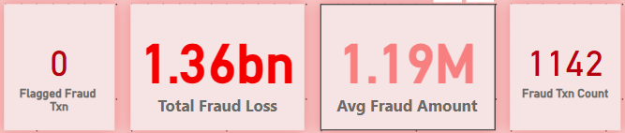
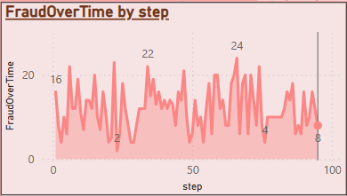

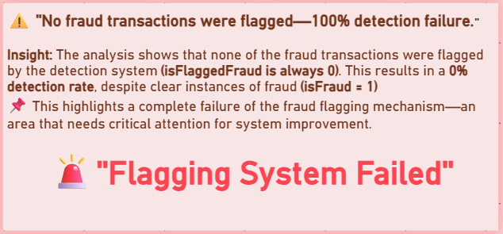
While exploring fraud trends over time, we spotted something strange.
At two specific time steps — Step 22 and Step 66 — there’s a sharp spike in fraudulent activity.
It's not a gradual rise; it's more like a sudden burst, which clearly stands out from the rest of the timeline.
The System Didn’t Catch a Single Fraud
In real-world systems, sudden spikes like this often point to a coordinated fraud attempt or a system vulnerability being exploited at a specific time — like a bot attack or a breach.
Spotting them early means we can respond faster and potentially stop large-scale fraud.
This isn’t just a gap — it’s a total system failure.
It’s like having a security guard who’s never raised the alarm.
No alerts, no flags, no intervention — even when fraud was massive.
Why This Insight is Crucial:
Highlights a detection logic breakdown or missing rule implementation
Shows urgent need for a review of fraud detection thresholds or rules
Emphasizes that data analysis helped uncover what the system couldn't
🧩 it helps as :
Triggers the need for time-based monitoring and alerts
Helps fraud prevention teams investigate what happened at those exact time steps
Can guide automation or rule creation to detect similar spikes in the future

Slide 6
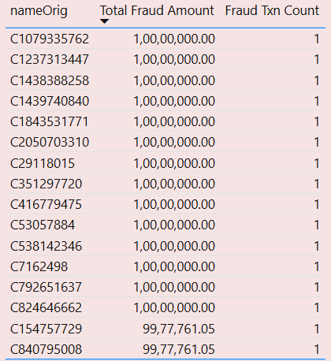
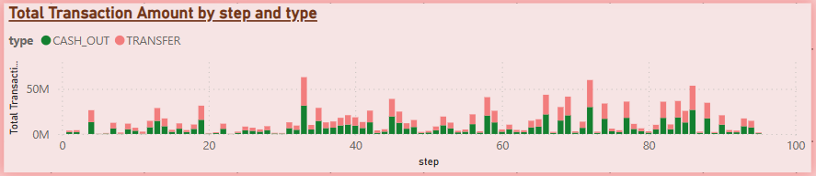

These Users Account for the Biggest Fraud Losses
High Value Transactions Flow Constantly — Fraud Hides in the Mix
💰 “One shot, huge impact — and the system missed it.”
We expected fraud to occur during high-value transaction surges. But interestingly, the biggest spikes in total amount aren’t necessarily the steps where most fraud happens.
Fraud hides not just in high-value bursts, but also during normal-looking periods — making it even harder to detect without deeper analysis.
It challenges the common assumption that fraud comes from repeat behavior.
Sometimes, it's a well-timed, single hit that causes the most loss.
So systems must flag suspicious behavior even for first-time users, especially when the amount is unusually high.
⚖️ Why This Insight Matters:
Just because a step has large amounts moving doesn’t always mean it’s fraudulent. And just because fraud counts are high doesn’t mean it’s the highest value loss.
That’s why relying on volume alone is risky — systems need to track both frequency and amount side-by-side.
Business/System Implications:
Amount-based thresholds alone are not enough
Calls for multi-layered detection: amount + type + time
Fraud detection must adapt to behavior, not just totals
Business/System Implications:
Calls for real-time amount-based thresholds
Urges detection logic to consider "sudden spikes from unknown users"
Highlights the importance of high-value fraud filters

Slide 7

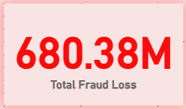
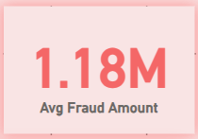
let’s dive into CASH_OUT
“Cash Out” is the final step in many fraudulent chains — once money is cashed out, it's gone.
And yet, not a single one of these transactions was flagged.
This isn’t just a miss. It’s a systemic blind spot in one of the most critical transaction types.
🚨 “Zero flagged , yet ₹680M vanished through Cash Out”

Slide 8
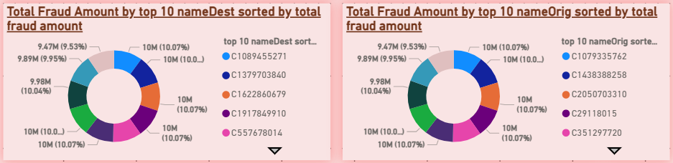
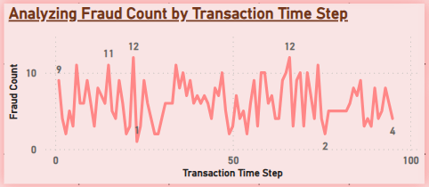
“Who’s Behind the Cash Out Frauds?”
“Temporal Fraud Clustering: When Transactions Become Traps”
As fraud analysts, we usually ask “who” or “how.” But in this case, the real power lies in “when.”
Our time-series view of Cash Out frauds revealed steep surges in activity at Steps 6, 15, 22, 34, 47, 58, 59, 66, and 74, alongside stable fraud bursts at sequences like 7–8, 31–32, 58–59, and 77–82.
This rhythmic behavior tells us that fraud isn’t chaotic — it’s strategic.
Surprisingly, when we examined who’s behind the Cash Out fraud, we didn’t find one or two culprits — we found dozens of users, each causing similar levels of loss (~₹10M).
This indicates widespread exploitation of the system — not a few masterminds, but many users abusing it in the same predictable pattern.
Strategic Business Implications:
1. This Is Patterned Fraud — Not Random Misuse
These aren’t isolated events. They show a clear behavioral cadence — likely driven by scripts, insider timing knowledge, or synchronized fraud rings.
It suggests fraud-as-a-service models may be at play — timed bot attacks that hit systems at predictable intervals.
2. Financial Impact Is Amplified by Clustering
When fraud occurs in bursts, it’s not just about the number of cases — it’s the concentration of loss in a narrow time window.
This overwhelms response systems, bypasses thresholds, and maximizes damage before detection can occur.
3. Time Is the Next Axis of Fraud Defense
Just like banks monitor transaction amount or location, they must now factor in timing —
Real-time rules triggered at Steps 22 or 66
Anomaly thresholds adjusted for fraud-heavy hours
Resource scaling aligned with fraud peaks
This Insight Helps:
Suggests Template-Based or Scripted Attacks
The fact that many users are defrauding in the same amount range hints at repetitive tactics — possibly automated or copycat attacks.
Calls for Behavior Pattern Detection
Detection logic should focus not just on identity, but transactional behavior patterns — repeated fraud-like sequences of send → transfer → cash out at certain thresholds.
Emphasizes Urgency for Network-Level Analysis
It demands holistic analysis of movement across accounts, timings, and thresholds.

Slide 9
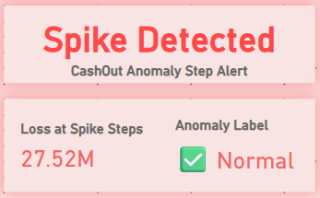
Spike Detected, But Flagged as “Normal” — Here’s Why
“This is the moment we realized — statistical intelligence isn’t enough.”
Even with advanced logic, ₹27.52M slipped through undetected.
This wasn’t a failure of data — it was a gap in behavioral intelligence.
Fraudsters bypass thresholds, but leave behind timing, value, and pattern clues.
The anomaly detection model is based on Z-score of fraud count per step — not just high-value transactions.
Since the number of fraud cases at steps 22 & 66 is within statistical limits, the system classifies it as “normal”.
🤖 Why This Happened:
The detection logic is based on Z-score of fraud count (not amount).
Since the number of fraud cases at Steps 22 and 66 was within statistical norms, the model didn’t flag it.
Loss ≠ Rarity — the system was blind to concentrated high-value attacks.
Examples of Behavioral Intelligence:
Unusual Timing Patterns
A user who only transacts at 3 a.m. or exactly at Step 22 repeatedly.
Transaction Chains
A transfer followed instantly by a cash-out — classic mule behavior.
Anomalous User Journeys
A user who never transacted before suddenly initiates 5 large transactions.
Scripted Behavior
Many users hitting the system at the same step or minute — likely a botnet.
Behavioral Intelligence in Fraud Detection
It looks at the patterns, timing, user actions, transaction types, and sequences — asking:
“Does this behavior make sense for this type of user, at this time, in this context?”

Slide 10
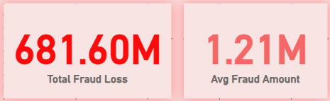
let’s dive into TRANSFER
“Transfer” is the launchpad for most fraudulent flows — the first move in laundering or rerouting money.
And yet, not a single one of these transactions was flagged.
This isn’t just oversight — it’s a foundational weakness in the fraud detection pipeline where the attack begins.
🚨 “Zero flagged , yet ₹681.60 M vanished through TRANSFER”

Slide 11
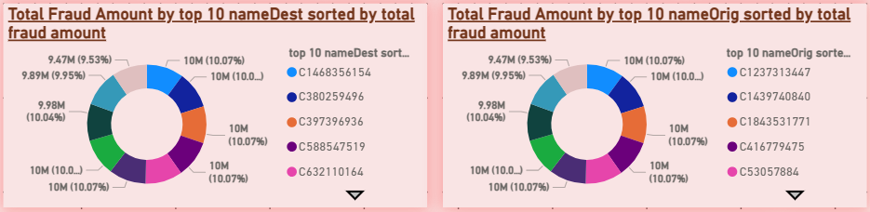
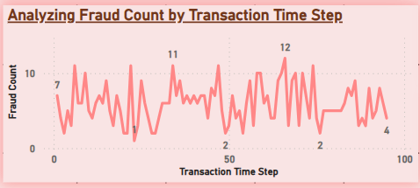
“Pattern Persists: Transfer Frauds Follow the Same Rhythmic Cadence”
“Who’s Behind the Transfer frauds?”
“Time isn’t just metadata. It’s a weapon.”
When we analyze the top 10 senders (nameOrig) and top 10 receivers (nameDest) in fraudulent Transfer transactions, we see a striking resemblance in fraud behavior to CashOut:
Each sender and receiver transacts exactly 10M or near-identical values.
Total fraud amount per user is nearly equal — indicating a structured, split-distribution strategy.
It’s unlikely for so many different users to coincidentally cause identical losses. This suggests a coordinated fraud ring, possibly using scripted automation or mule accounts.
“Fraud is not only timed — it’s templated. And every time this template runs, the system bleeds 10 million.”
Even when we isolate TRANSFER transactions, we see a familiar pattern — fraud doesn't scatter randomly across time.
Instead, it clusters again at Steps 6, 15, 22, 34, 47, 58–59, and 66 — just like in CashOut.
This isn’t coincidental. It’s a replication of behavior across transaction types — and likely suggests either:
Reuse of the same bot scripts
Or a single fraud model operating across multiple channels.
Business Implication:
This is not petty theft — it’s engineered financial fraud.
Calls for:
Real-time link analysis between suspicious sender-receiver chains
User clustering to detect multi-account fraud models
Alerts when a user sends/receives the same fixed amount repeatedly
Shows the fraud ring is channel-agnostic — they're exploiting both Transfer and CashOut pipelines with the same timing logic.
You need a cross-transaction-type anomaly detection strategy — not one model per transaction type.
Emphasizes behavioral signatures over transaction names.

Slide 12
“Fraud Isn't Just Repeating — It's Replicating Across Channels”
“What If This Dashboard Could Defend Itself?”
no fraud was flagged
issues
statistical models alone failed
Key Takeaways:
🔹 1. Timed Fraud Patterns Persist in Transfer Transactions
Even when we drill into only Transfer transactions, we see the same fraud spike steps as in CashOut:
Steps 6, 15, 22, 34, 47, 58–59, 66
📌 Confirms this isn’t random — it’s a system-wide, time-coordinated attack strategy.
🔹 2. Top Fraud Users Show Scripted Behavior
All top 10 senders and receivers in Transfer frauds show nearly identical amounts (10M).
📌 Indicates automation, mule accounts, or bots executing a predefined fraud template.
🔹 3. ₹681.6M Lost — Zero Flagged
Despite high fraud volume and repetition, not a single Transfer fraud was flagged.
📌 Exposes a major weakness in existing fraud detection — rule-based flagging fails here.
Behavior is repeated and templated
Losses were concentrated but missed
🛡️ Recommendation: Build a Hybrid Fraud Defense Engine
1. Behavior-Aware Alerting System
Train models not just on fraud counts, but on:
Timing (steps)
Repetitive user patterns
Fixed transaction amounts
Cross-type replication
This isn’t just anomaly detection — it’s fraud behavior modeling.
2. Auto-Learn from Spikes
Whenever a fraud spike is detected —
store its signature (step, amount, user type) and feed it back into alert logic.
-> Create a self-improving fraud firewall.
3. Add Explainable AI Layer
Integrate an Explainable ML model that not only flags a transaction but explains:
“Why was this flagged?”
“What’s similar to previous frauds?”
“Has this pattern been seen in another transaction type?”
Fraud Behavior Transcends Transaction Labels
Despite changing from CashOut to Transfer, the fraudsters didn’t change strategy.
📌 This reveals something deeper: the fraud pattern isn’t tied to transaction types — it’s tied to fraud logic.
✅ This is key because it:
Shifts detection focus from “what kind of transaction” to “how the transaction behaves”
Calls for user- and behavior-based monitoring, not just transaction-type models
“We didn’t just find fraud. We mapped its DNA — and built a plan to intercept its next move.”

Slide 13
Thank You

